Slide 1

DAY 1
Embedded Systems
and IoT
Introduction to Embedded Systems & IoT; Day -1
By- Chandramouli Haldar
Notes:
Welcome slide. Click "Start lesson" to open the agenda.

Slide 2



BASICS
What is an Embedded System?
A specialized computing device
An embedded system is a specialized computing device designed for a specific task within a larger mechanical or electrical system
Not a general-purpose computer
Unlike general-purpose computers, these systems combine hardware and software to perform dedicated functions often in real-time such as washing machine, Home Automation, or operating a medical device
Why embedded ?
because it is a specialized computer system integrated within a larger mechanical or electrical product to perform a specific function
3
Notes:
Definition. Three key ideas: specialised, dedicated function, embedded inside a larger product.

Slide 3
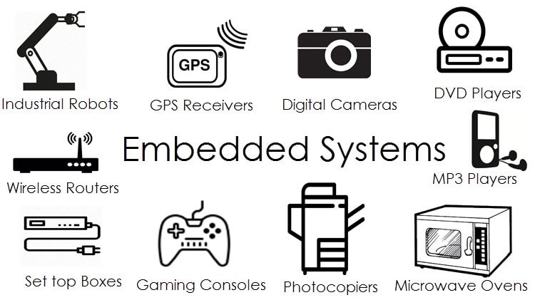
BASICS
Applications of Embedded Systems
4

Slide 4




BASICS
Why Do We Need Embedded Systems?
01
02
03
To automate tasks
To make devices smart
To reduce human effort
04
05
06
To work fast and reliably
Compact and lightweight design
Cost-effective solutions
5
Notes:
Six reasons. Ask the class to give a real-life example for each.

Slide 5
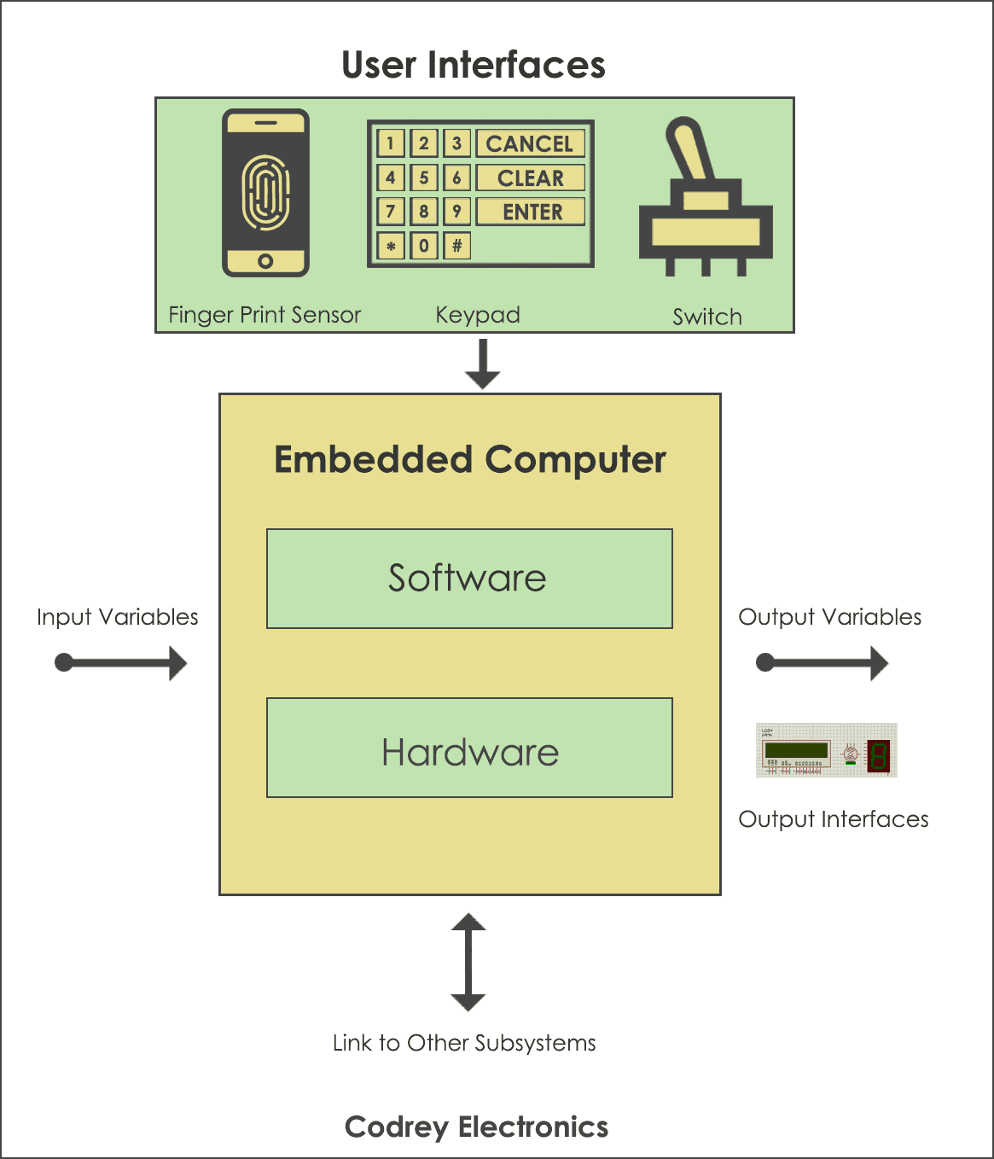




BASICS
How Does an Embedded System Work?
INPUT
PROCESS
OUTPUT
Input → Process → Output
6
Notes:
Walk through Input → Process → Output using a washing machine.

Slide 6
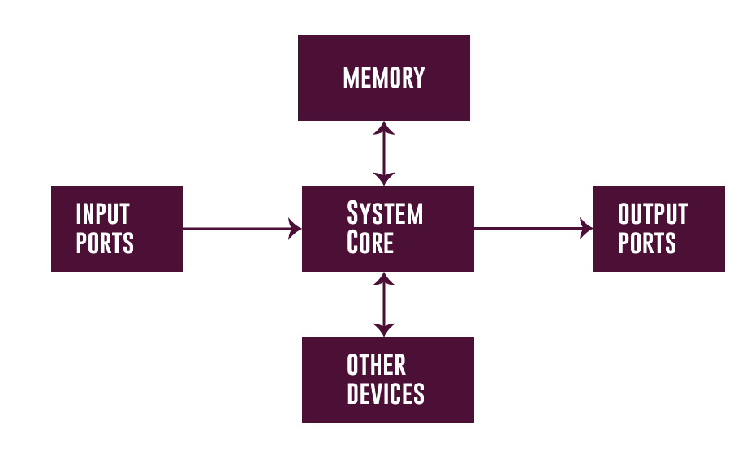
BASICS
Components of Embedded Systems
7

Slide 7


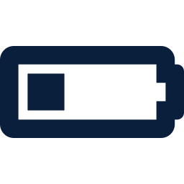


CHARACTERISTICS
Characteristics of an Embedded System
Performs specific task:
Embedded systems perform some specific function or tasks.
Low Cost:
The price of an embedded system is not so expensive.
Time Specific:
It performs the tasks within a certain time frame.
Low Power:
Embedded Systems don't require much power to operate.
High Efficiency:
The efficiency level of embedded systems is so high.
19
Menu
Notes:
Ask: which of these does a microwave oven demonstrate?

Slide 8




CHARACTERISTICS
Characteristics of an Embedded System
Minimal User interface:
These systems require less user interface and are easy to use.
Less Human intervention:
Embedded systems require no human intervention or very less human intervention.
Highly Stable:
Embedded systems do not change frequently mostly fixed maintaining stability.
High Reliability:
Embedded systems are reliable they perform tasks consistently well.
20
Menu
Notes:
Ask: which of these does a microwave oven demonstrate?

Slide 9
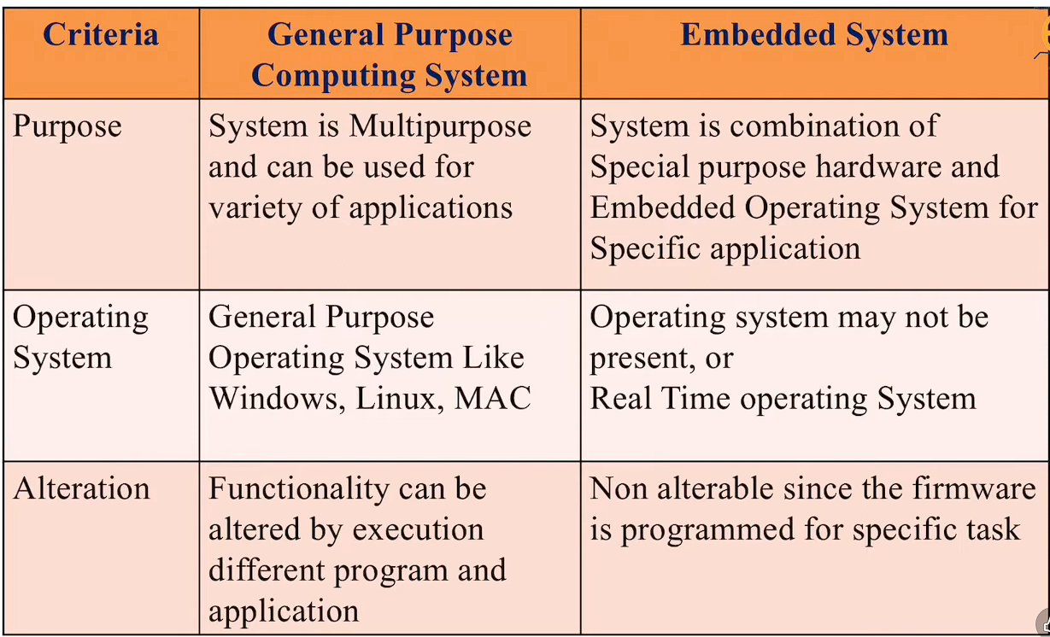
CHARACTERISTICS
Difference Between General Purpose Computer vs Embedded systems
21
Menu
Notes:
Compare purpose, operating system, alteration.

Slide 10


CHARACTERISTICS
Advantages / Disadvantages of Embedded systems
Advantages
Disadvantages
High Efficiency and Performance
Limited Processing Power
Low Power Consumption
Limited Flexibility and Upgradability
Compact Size
Development Complexity
Cost-Effectiveness
Cost of Development (Initial)
Real-Time Capabilities
Scalability Issues
Reliability and Stability:
Maintenance and Support
22
Menu
Notes:
Contrast the two columns. Which disadvantage would matter most for a medical device?

Slide 11
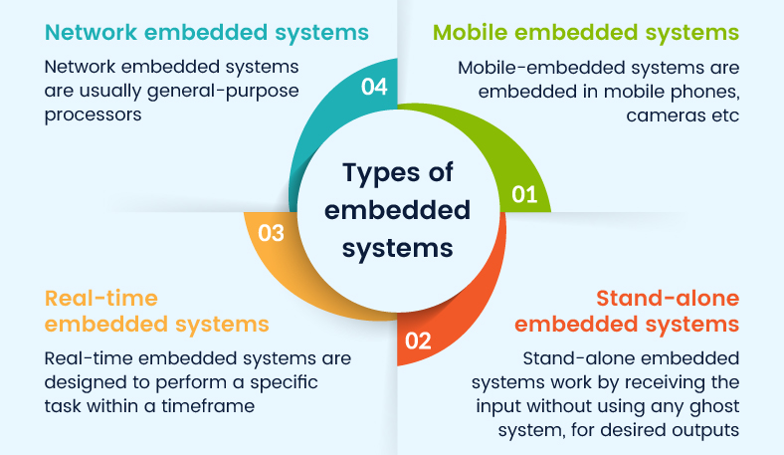
CHARACTERISTICS
Types of Embedded System
23
Menu

Slide 12


COMPONENTS
Components of an Embedded System
An embedded system mainly has:
1
2
3
4
5
Input Devices
Processor (Microcontroller)
Output Devices
Power Supply
Software
37
Menu
Notes:
The five building blocks. We will go through each one.

Slide 13
COMPONENTS
1. Input Devices
EXAMPLES
What is Input?
Switch
Input is how an embedded system receives information.
Button
Temperature sensor
ROLE
Light sensor
Sends data/signals to the microcontroller
Keypad
38
Menu

Slide 14
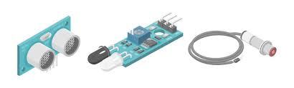
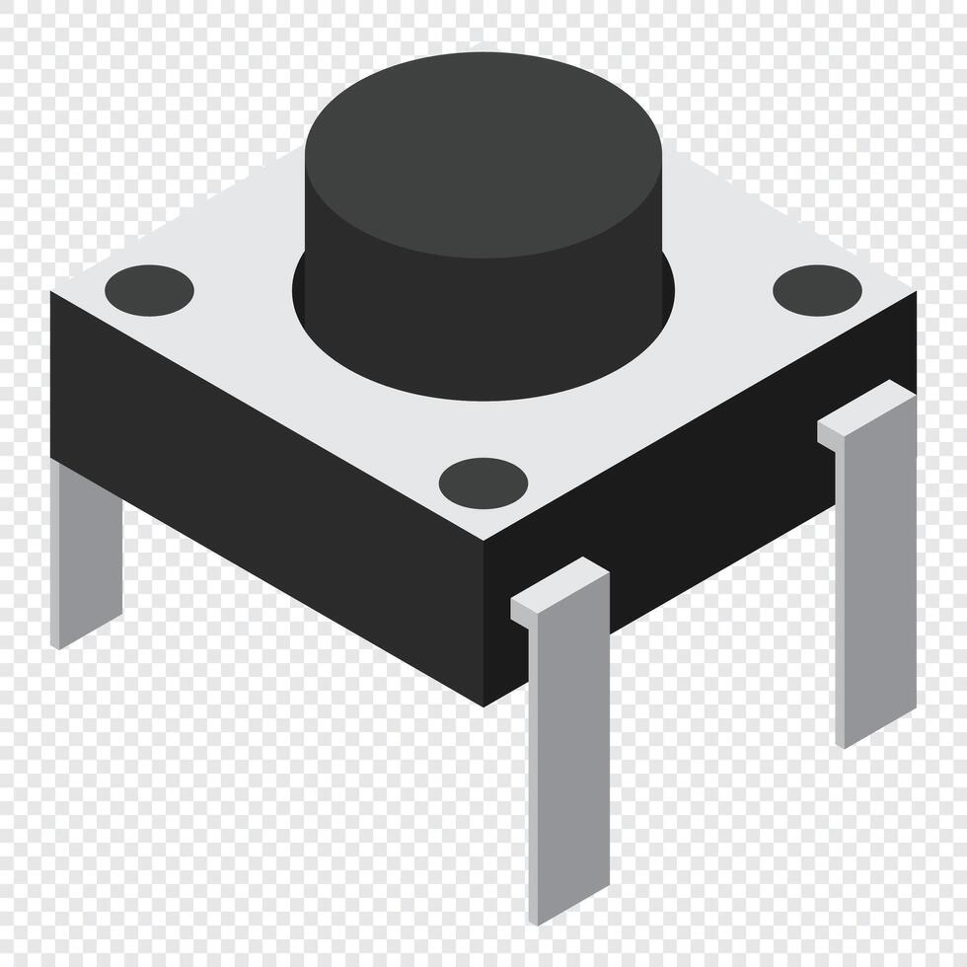
COMPONENTS
How Input Devices Work?
Example: Button
Example: Sensor
1
Button pressed → signal changes
1
Physical change → electrical signal
2
Microcontroller detects HIGH / LOW
2
Signal goes to microcontroller
3
Program responds
39
Menu
Notes:
Show a button press and a sensor reading on a real board if you have one.

Slide 15


COMPONENTS
2. Processor (Microcontroller)
Microcontroller = Brain
What it does:
Examples:
Reads input data
8051
Processes data using program
Atmega
Controls output devices
Arduino
40
Menu
Notes:
The microcontroller is the brain.

Slide 16
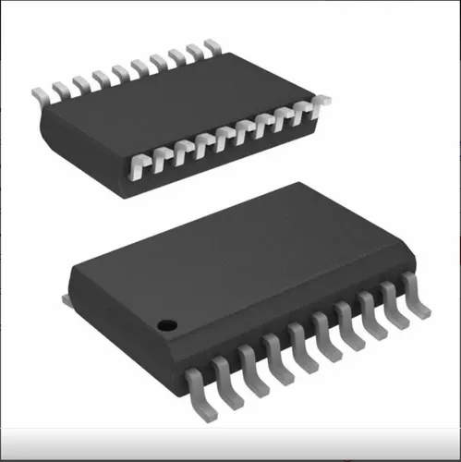
COMPONENTS
How Microcontroller Works?
Step-by-step:
1
Reads input from pins
2
Executes program (logic)
3
Decides what to do
4
Sends signal to output
Use Input → Logic → Output
41
Menu

Slide 17
COMPONENTS
3. Output Devices
EXAMPLES
What is Output?
LED
Output is how the system shows results.
LCD display
Motor
ROLE
Buzzer
Acts based on controller decision
Relay
42
Menu

Slide 18

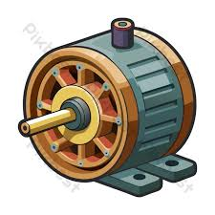
COMPONENTS
How Output Devices Work?
Example: LED
Example: Motor
1
Controller sends signal
1
Controller controls driver
2
LED ON / OFF
2
Motor rotates or stops
Keep it very practical.
43
Menu
Notes:
Keep it very practical.

Slide 19

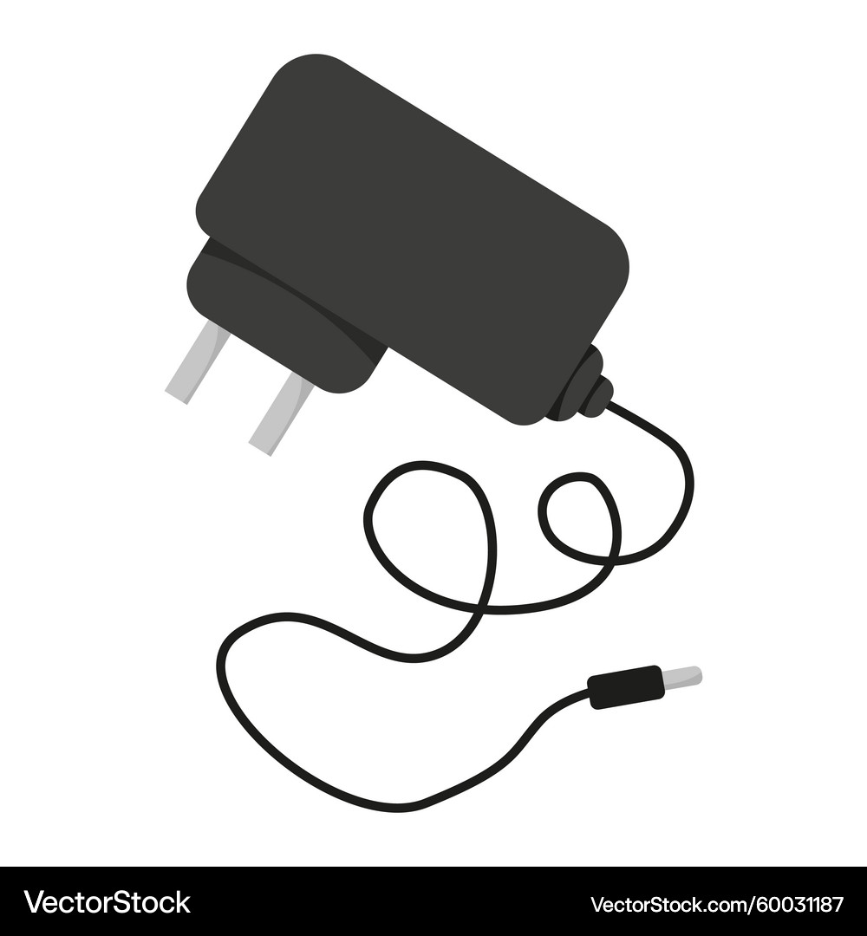
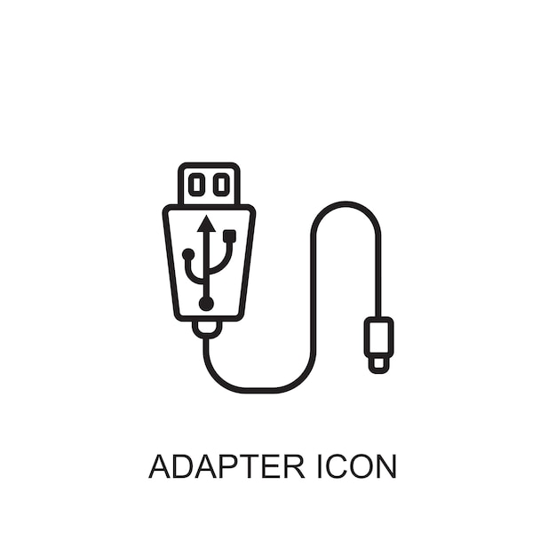
COMPONENTS
4. Power Supply
Battery
Why power supply is important
Provides required voltage
Ensures stable operation
Adapter
Common sources:
Battery
Adapter
USB
USB
Remember: “Wrong power = dead system.”
44
Menu
Notes:
Wrong power = dead system. Demonstrate with a 3.3V vs 5V board discussion later (ESP vs Arduino).

Slide 20

COMPONENTS
5. Software (Program)
Software tells hardware what to do
Written using:
Embedded C
Arduino code
Assembly
Without software:
Hardware is mostly useless
45
Menu
Notes:
Without software hardware is mostly useless.

Slide 21
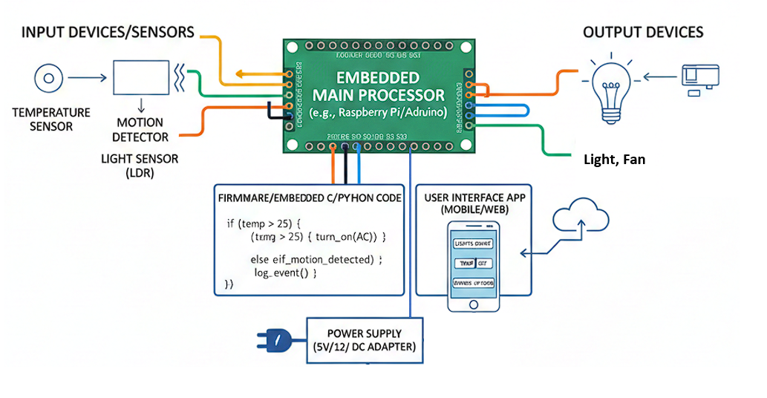
EXAMPLES
Example 1. Home automation
46
Menu

Slide 22
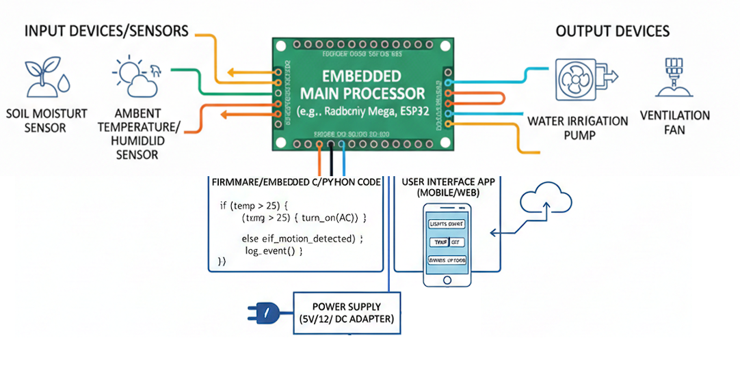
EXAMPLES
Example 2. Smart Agriculture
47
Menu

Slide 23
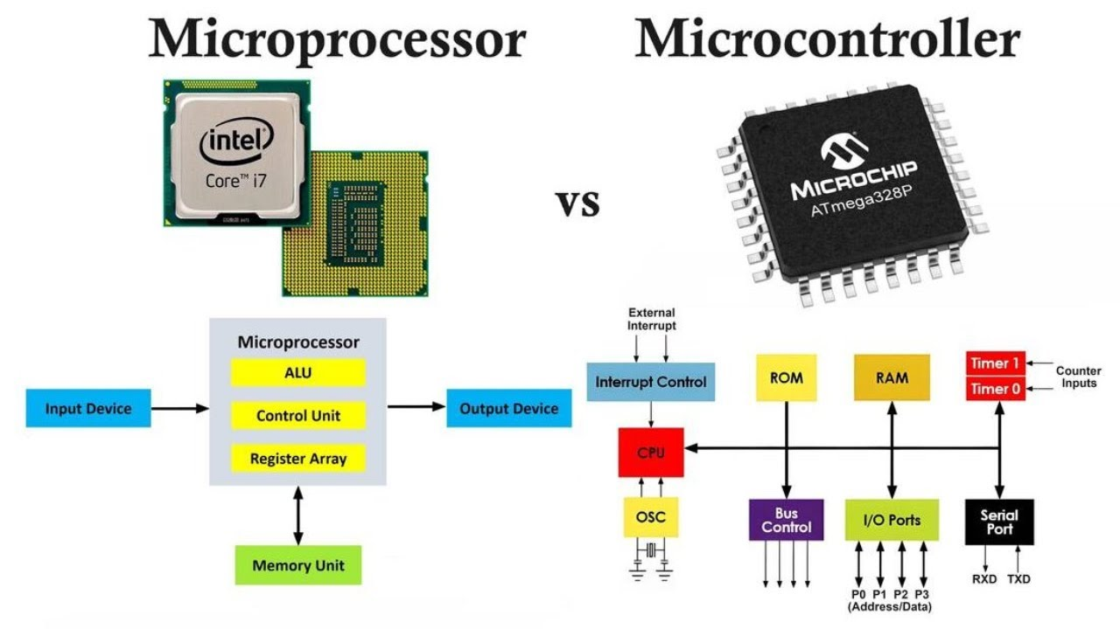
MCU VS MPU
Microcontroller VS microprocessor
48
Menu

Slide 24
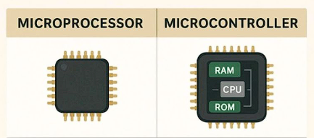
MCU VS MPU
Microcontroller VS microprocessor
Microcontroller units (MCUs) and microprocessor units (MPUs) are two kinds of integrated circuits that, while similar in certain ways also very different in many others.
The key difference between these two units is that microcontrollers combine all the necessary elements like Memory, Storage, input/output (I/O) components into a single chip, and Microprocessor require all this externally to work.
49
Menu
Notes:
Key difference: MCU has memory + I/O on one chip; MPU needs them externally.

Slide 25
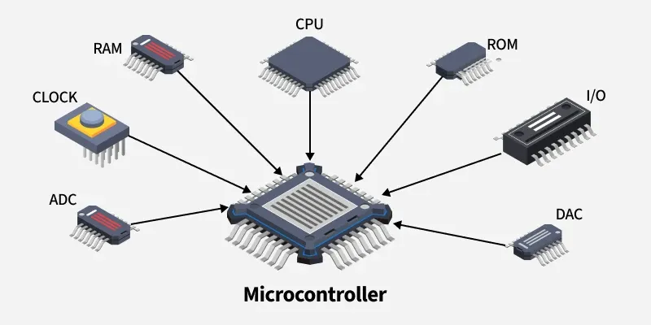
MCU VS MPU
Microcontroller
Microcontroller is a small computer on a single chip, containing a processor core, operational memory (RAM) and electrically erasable programmable read-only memory (EEPROM) for program memory, some I/O interfaces, and ADCs (Analog to Digital converters.
50
Menu

Slide 26
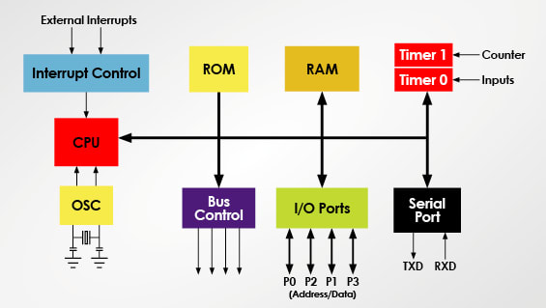
MCU VS MPU
Components of a Microcontroller
51
Menu

Slide 27
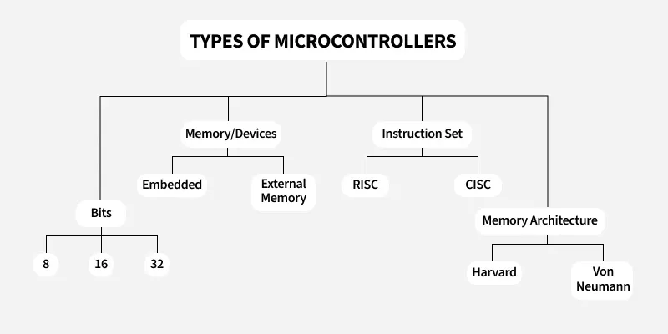
MCU VS MPU
Types of Microcontrollers
52
Menu

Slide 28

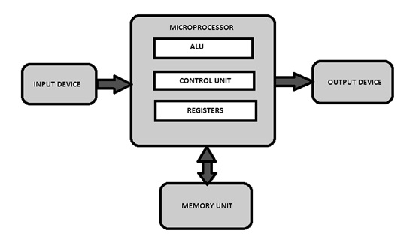
MCU VS MPU
Microprocessor
A Microprocessor is a programmable device that takes in input, performs some arithmetic and logical operations over it and produces the desired output. In simple words, a Microprocessor is a digital device on a chip that can fetch instructions from memory, decode and execute them, and give results.
53
Menu

Slide 29
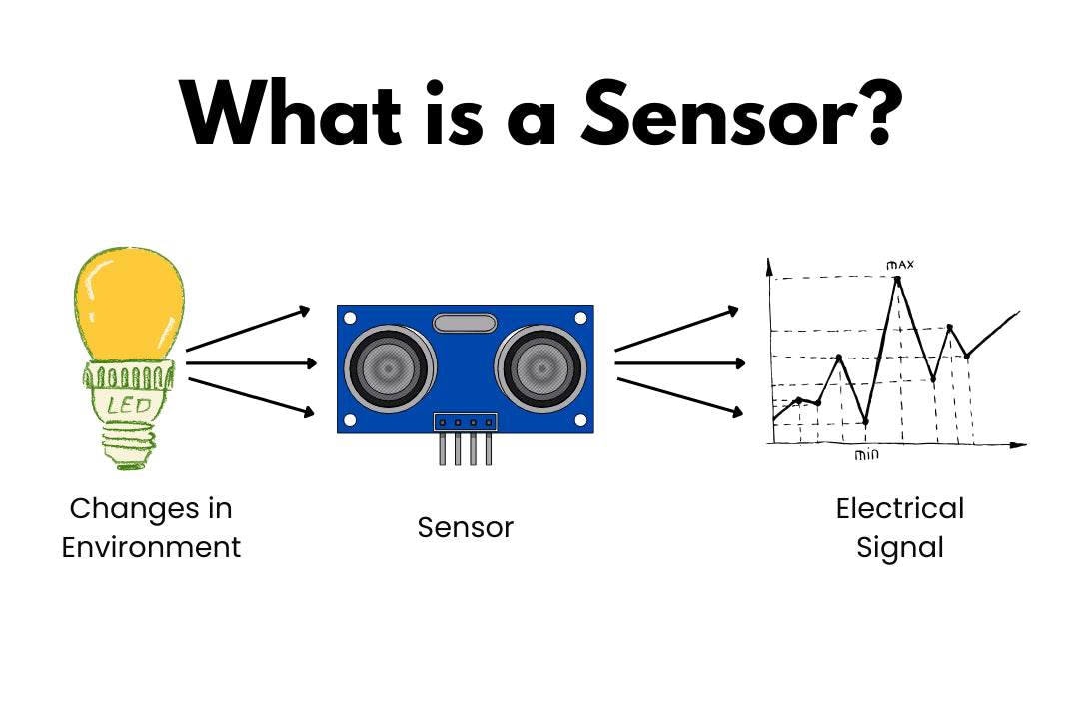
SENSORS & ACTUATORS
Sensor
A sensor is a device that detects physical, or environmental input—such as light, heat, motion, moisture, or pressure—and converts it into a signal, typically electrical, that can be measured, interpreted, or used to trigger a response
54
Menu

Slide 30
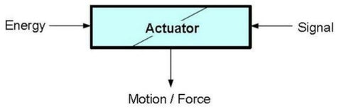
SENSORS & ACTUATORS
Actuators
Actuator is a device that converts the electrical signals into the physical events or characteristics. It takes the input from the system and gives output to the environment.
For example, motors and heaters are some of the commonly used actuators.
55
Menu

Slide 31

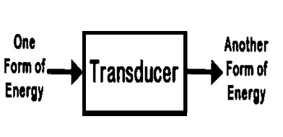
SENSORS & ACTUATORS
Transducer
A transducer is a device that converts energy from one form into another, typically transforming physical quantities (such as pressure, temperature, light, or motion) into measurable electrical signals, or vice versa.
For Example: Microphone, Motor, etc.
56
Menu

Slide 32
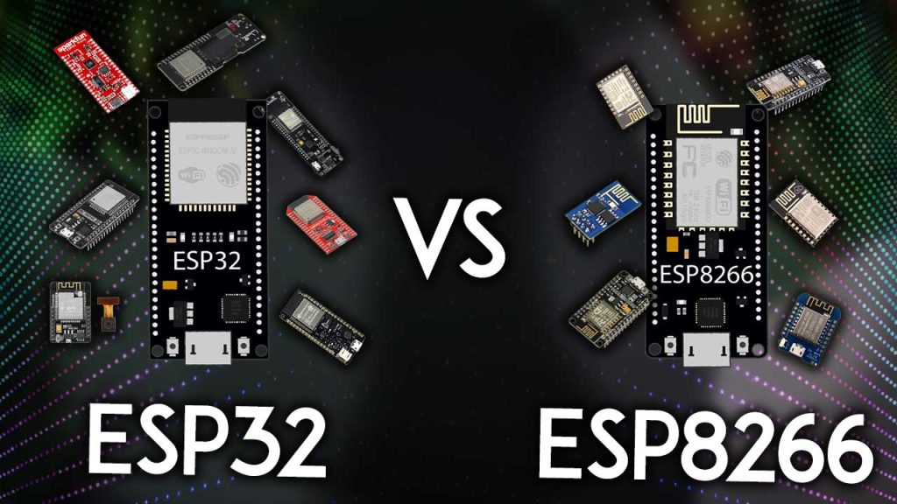
ESP
ESP32 vs ESP8266
68
Menu

Slide 33
ESP8266
Introduction to ESP8266
What is NodeMCU? The NodeMCU (Node MicroController Unit) is an open-source software and hardware development environment built around an inexpensive System-on-a-Chip (SoC) called the ESP8266.
Chip Set
ESP8266EX, 32-bit Tensilica L106
Operating Voltage
3.3 V
Operating Frequency
Up to 80 MHz (160 MHz overclocking supported)
Wi-Fi
Built-in 2.4 GHz Wi-Fi (802.11 b/g/n)
GPIO
Up to 17 GPIO pins and 1 ADC channel (A0)
PWM
Software-based PWM available on GPIO pins for controlling LEDs, motors, and other devices
Communication Interfaces
UART, SPI, and I²C support
69
Menu

Slide 34
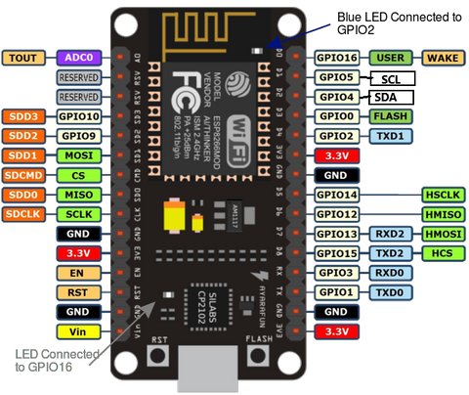
ESP8266
NodeMCU ESP8266 Pinout
70
Menu

Slide 35
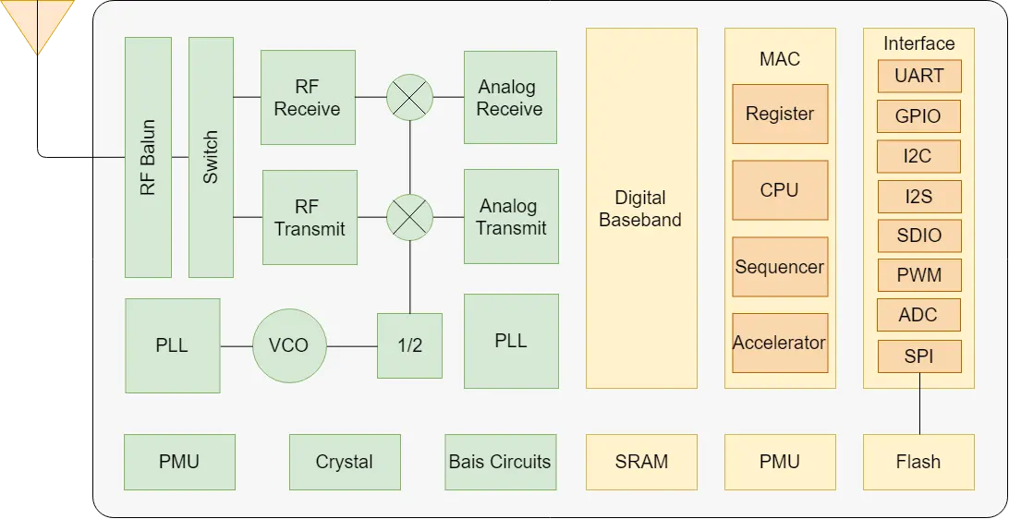
ESP8266
ESP8266 Block Diagram
71
Menu

Slide 36




ESP32
Introduction to ESP32
Key Features:
What is ESP32?
Built-in Wi-Fi (2.4 GHz) and Bluetooth (BLE + Classic)
A low-cost, powerful microcontroller developed by Espressif
Dual-core processor (up to 240 MHz)
Chipset : Tensilica Xtensa Dual-Core 32-bit LX6
Multiple GPIO pins (digital & analog)
Successor to ESP8266 with advanced features
Supports ADC, DAC, PWM, UART, SPI, I2C
Designed for IoT (Internet of Things) applications
520 KB of internal SRAM, 448 KB of ROM
72
Menu
Notes:
ESP32 is the successor to the ESP8266, with Bluetooth and dual-core.

Slide 37



ESP32
Why ESP32 is Better?
Ideal for IoT, automation, and embedded systems
Smart home systems
Wearable devices
More powerful than Arduino UNO
Cost-effective and widely supported
Common Applications:
Tap the tiles on the right →
Industrial automation
Wireless sensor networks
73
Menu
Notes:
Discuss why we prefer ESP32 for IoT projects.

Slide 38
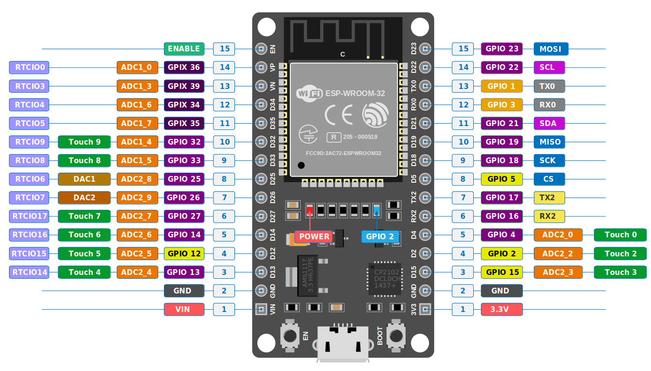
ESP32
ESP32 Pinout
74
Menu

Slide 39
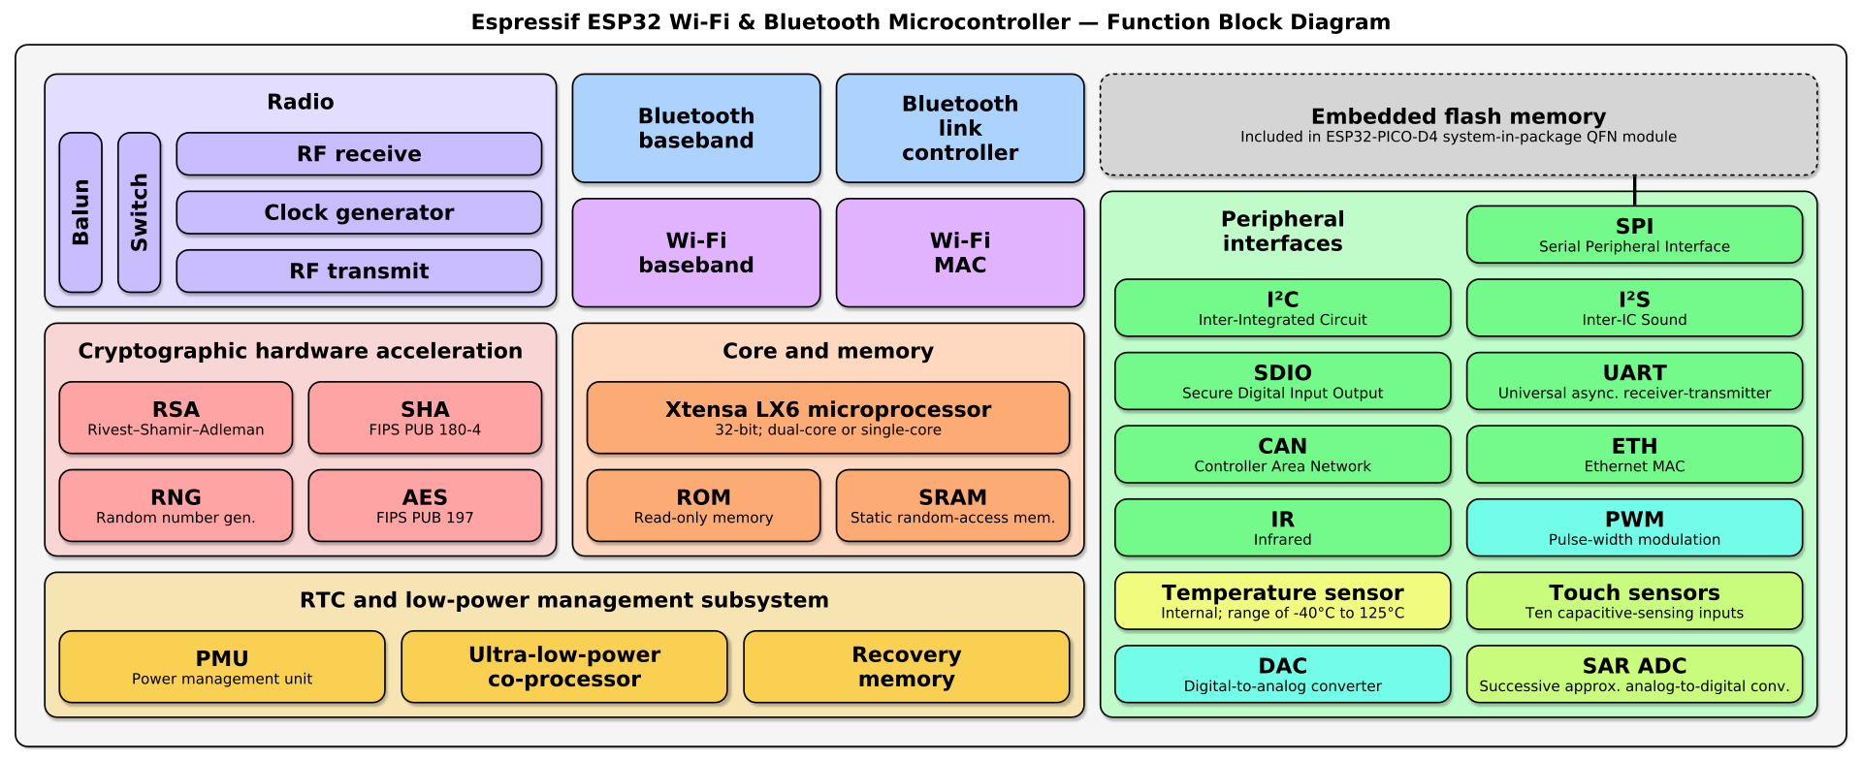
ESP32
ESP32 Function Block Diagram
75
Menu

Slide 40
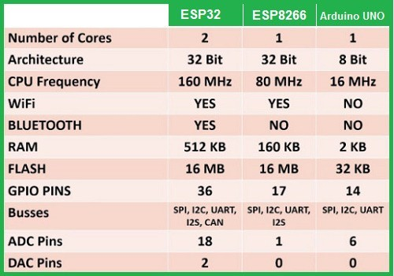
ESP32
ESP32 vs ESP8266 vs Arduino UNO
76

Slide 41
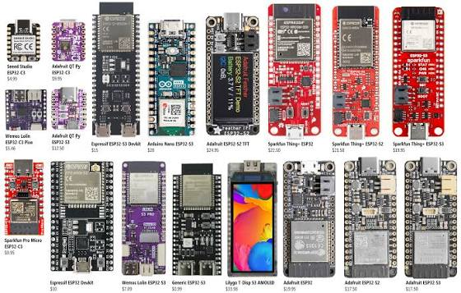
ESP32
ESP Boards
77
Menu

Slide 42
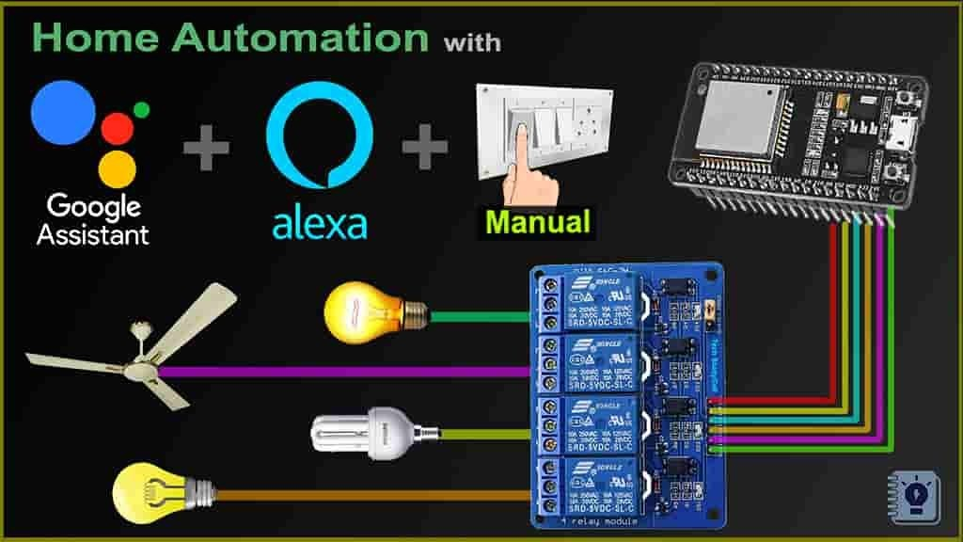
IOT
IoT Applications
78
Menu

Slide 43
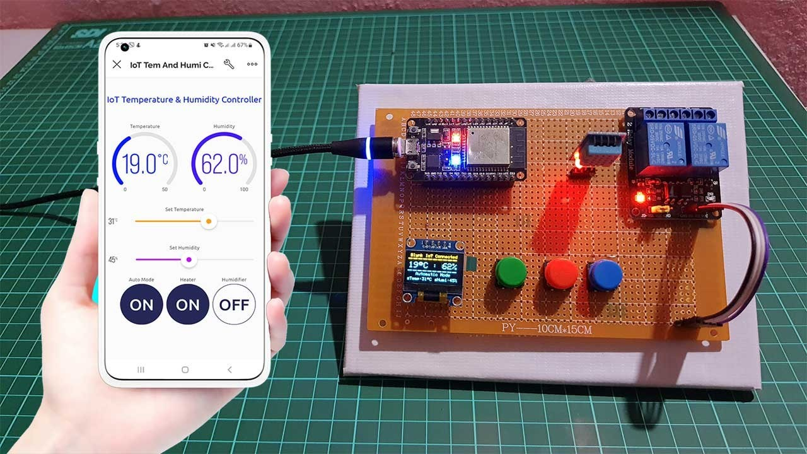
IOT
IoT Temperature & Humidity Monitoring & Control System using ESP32
79
Menu

